Slide 1
Poland

Slide 2
Information
Poland, officially the Republic of Poland is a country in Central Europe, bordered by Germany to the west; the Czech Republic and Slovakia to the south; Ukraine and Belarus to the east; and the Baltic Sea, Kaliningrad Oblast and Lithuania to the north. The total area of Poland is 312,679 square kilometres, making it the 71st largest country in the world and the 9th largest in Europe. With a population of over 38.5 million people, Poland is the 34th most populous country in the world, the 8th most populous country in Europe and the sixth most populous member of the European Union, as well as the most populous post-communist member of the European Union. Poland is a unitary state divided into 16 administrative subdivisions.

Slide 3
Location and territory

Slide 4
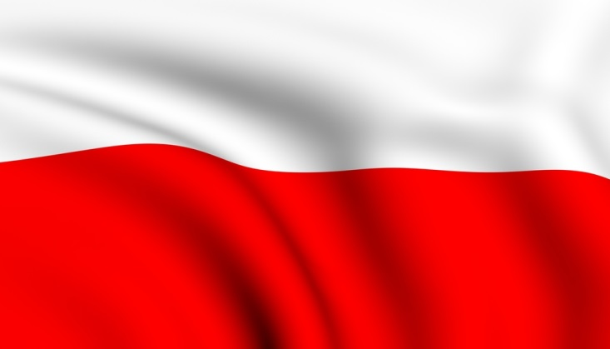
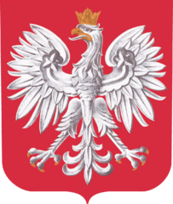
National symbols
Flag
National anthem „Mazurek Dąbrowskiego”
Emblem

Slide 5
Capital City
Warsaw is the capital and largest city of Poland. It stands on the Vistula River in the east-central Poland, roughly 260 kilometres from the Baltic Sea and 300 kilometres from the Carpathian Mountains. Its population is estimated at 1.740 million residents within a greater metropolitan area of 2.666 million residents, which makes Warsaw the 9th most-populous capital city in the European Union.

Slide 6
Warsaw

Slide 7
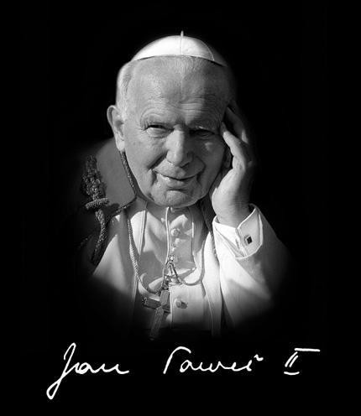
Famous people

Slide 8
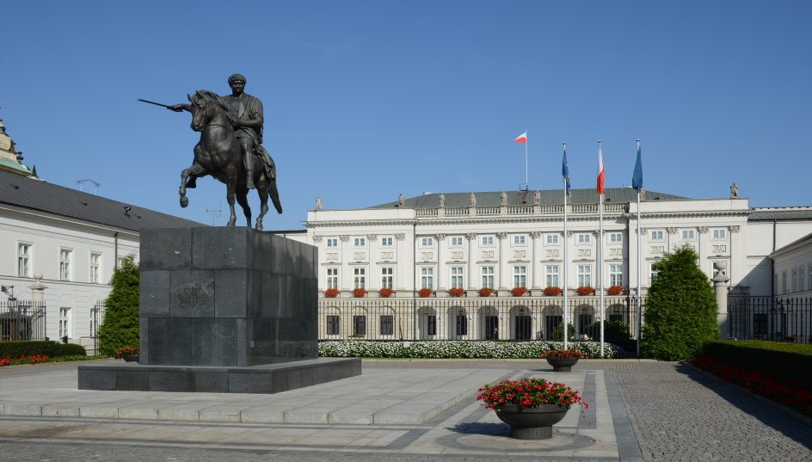
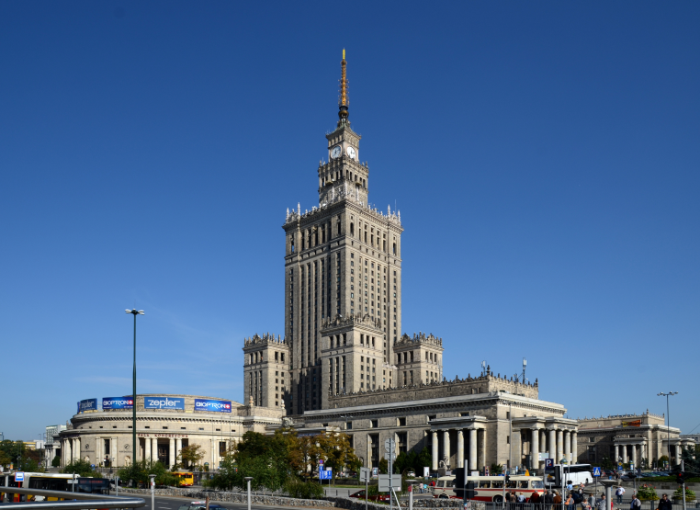
Famous places

Slide 9
The end
Patrick Kapica
Simon Czajka

