Slide 1
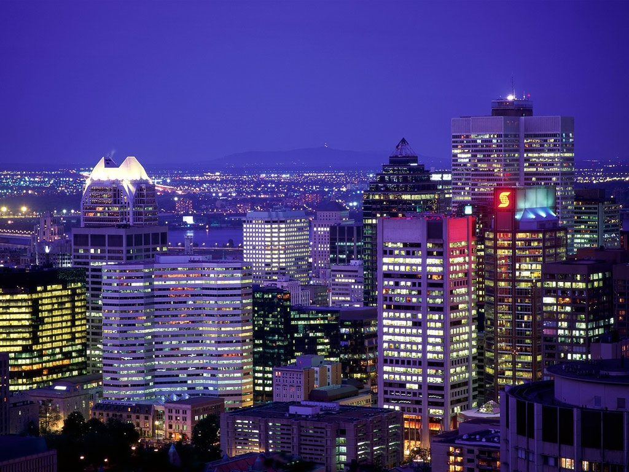
Canada

Slide 2
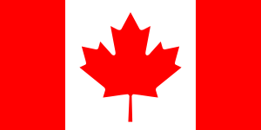
The national flag of Canada also known as the Maple Leaf is a red flag with a white square in its centre, featuring a stylized 11-pointed red maple leaf.

Slide 3
„
„O Canada" is the national anthem of Canada.

Slide 4
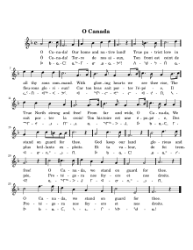
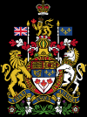
List of symbols:
National symbols of Canada are the symbols that are used in Canada and abroad to represent the country and its people.
Royal Standard
National flag
National Anthem
Royal Arms
Great Seal
Floral emblem

Slide 5
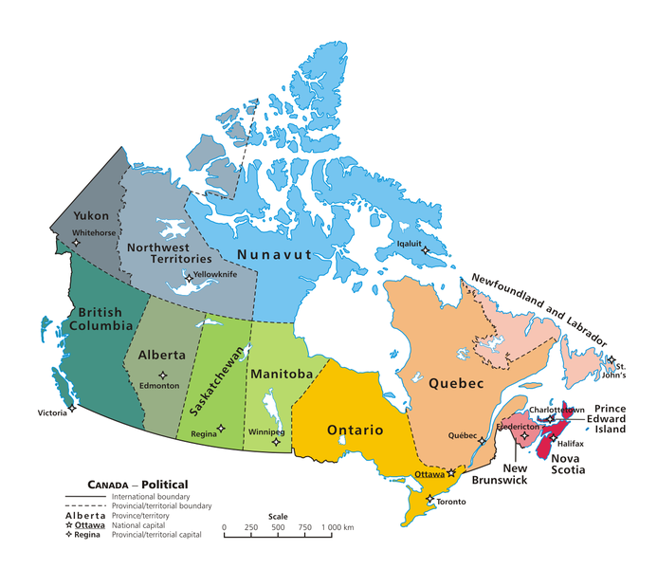
Canada border on land
only with the
United States.
There are ten provinces
and three territories

Slide 6
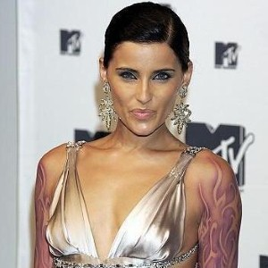
Famous Canadians:
Pamela Anderson
the actress and the model, She is associated with the People organization for the Ethical Treatment of Animals. She achieved fame playing in the „Baywatch”.
Celine Dion
is a singer. Apart from singing he is dealing largely with charity activity.
Nelly Furtado is a singer. She is able to play the trombone, and the keyboard. She wrote the first texts at the age of 7.

Slide 7
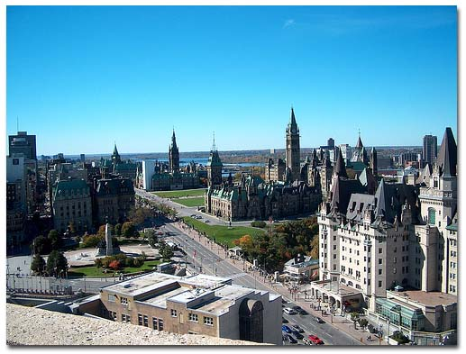
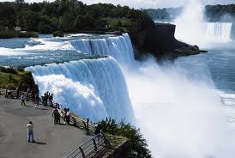
Famous Places in Canada:
Niagara Falls
Ottawa is the Capital City of Canada and a great place to soak in Canadian culture.
The Canadian side of the Falls is perhaps the most visited region in Ontario. he area offers casinos and theme parks along with the natural spectacle of Horseshoe Falls.
More information on: famous places

Slide 8
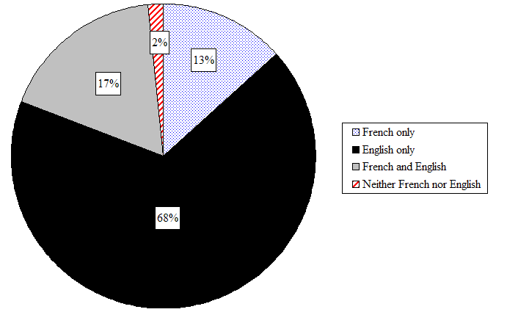
Languages of Canada
A multitude of languages are used in Canada. According to the 2006 census, English and French are the mother tongues. New Brunswick is the only Canadian province that has both English and French as its official languages. Quebec's official language is French. English and French are recognized by the Constitution of Canada as "official languages." This means that all laws of the federal government are enacted in both English and French and that federal government services must be available in both languages.

Slide 9
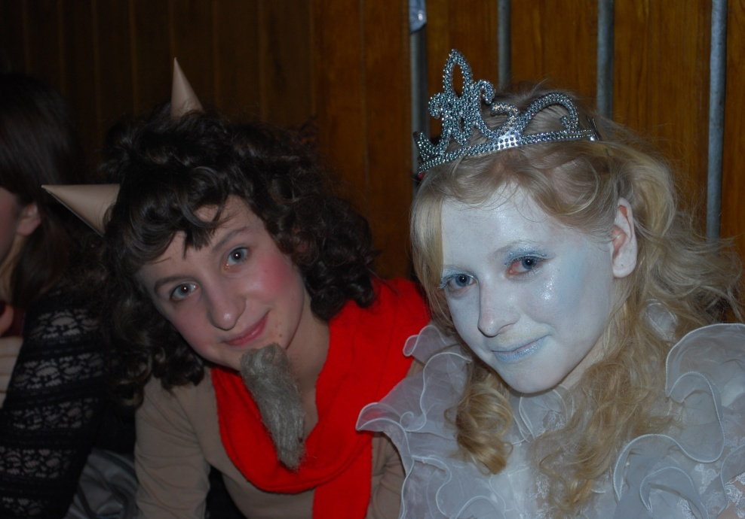
Wykonały:
Kinga Mazurek
Sylwia Zygmunt
Korzystałyśmy z:
Wikipedii.

