Slide 1
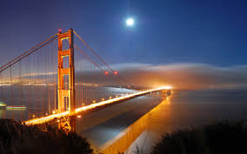
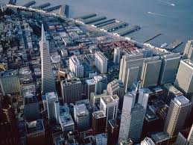
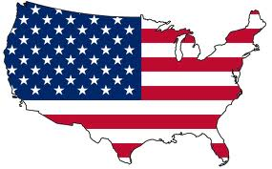
USA
The United States of America

Slide 2
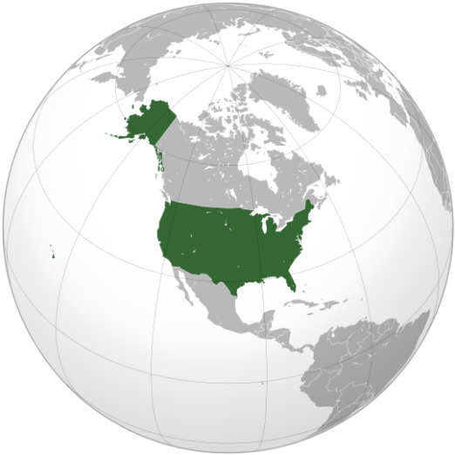
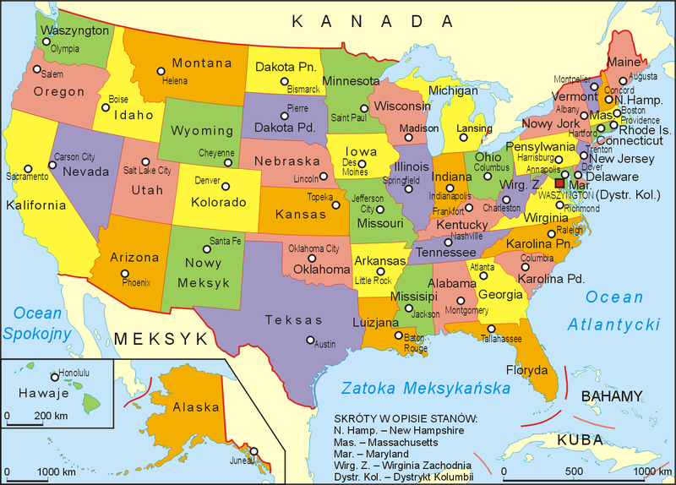
Teritory
United States consists of 50 states.
It lies between the Pacific and Atlantic Oceans, bordered by
Canada to the north and Mexico to the south.

Slide 3
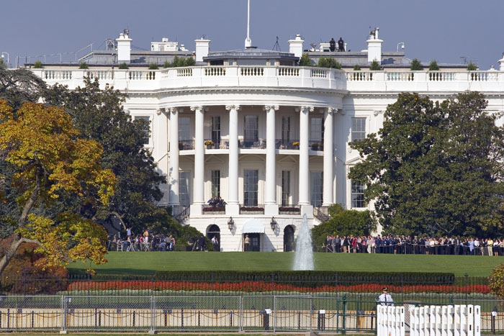
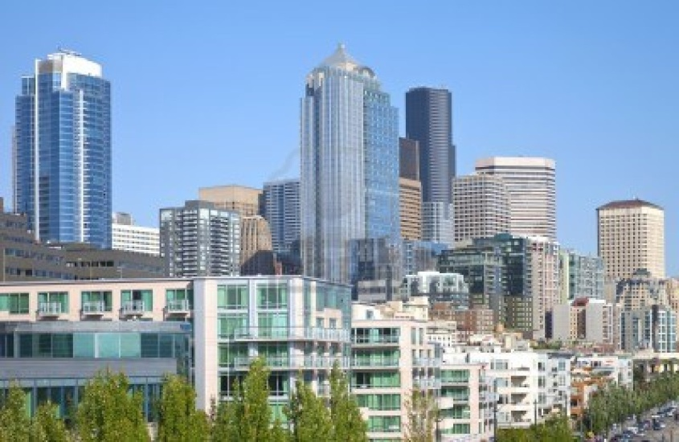
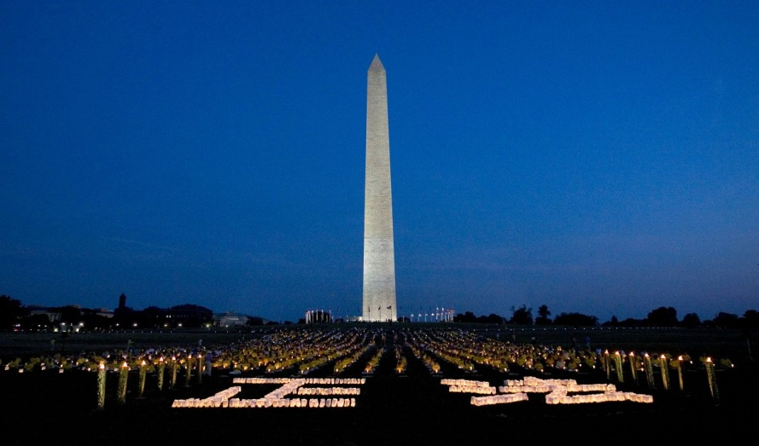
Capital City
The capital city of the United States of America is Washington DC.
The White House - the official residence of the USA President.

Slide 4
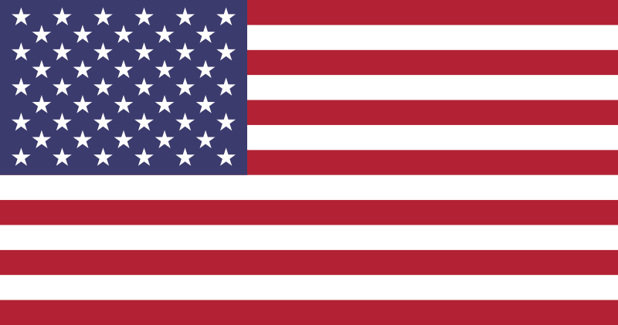
Flag
Flag of the United States is commonly known as the Stars and Stripes
Stars represent 50 states of the U.S.
Stripes symbolize 13 original colonies

Slide 5
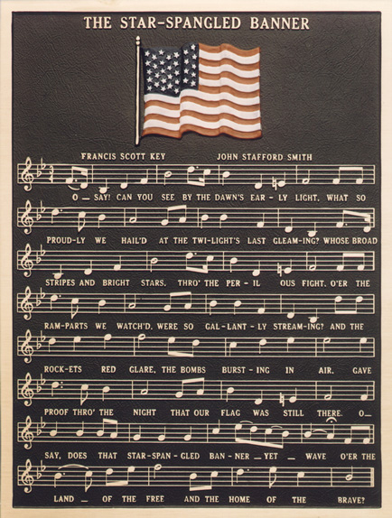
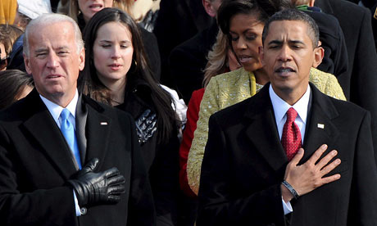
National Anthem
„The Star-Spangled Banner” - is a national anthem of the United States

Slide 6
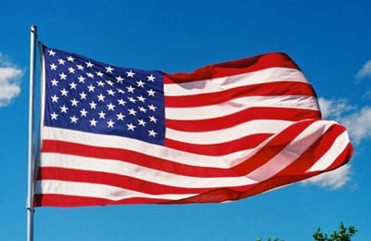
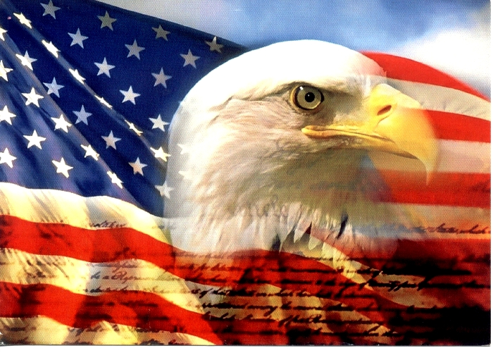
National symbols
FLAG
BALD EAGLE

Slide 7
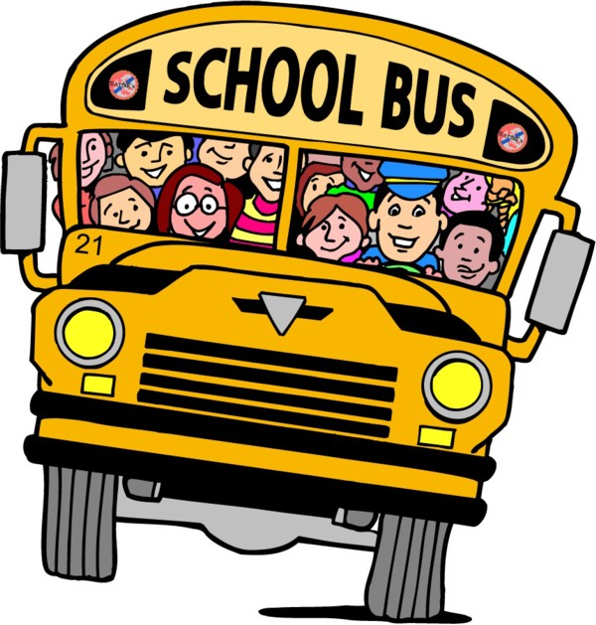
LANGUAGE
In the United States most people speak English, there is also big group of Spanish speakers.
Some words in British and American English are different eg. in Britain you play football while in America soccer.

Slide 8
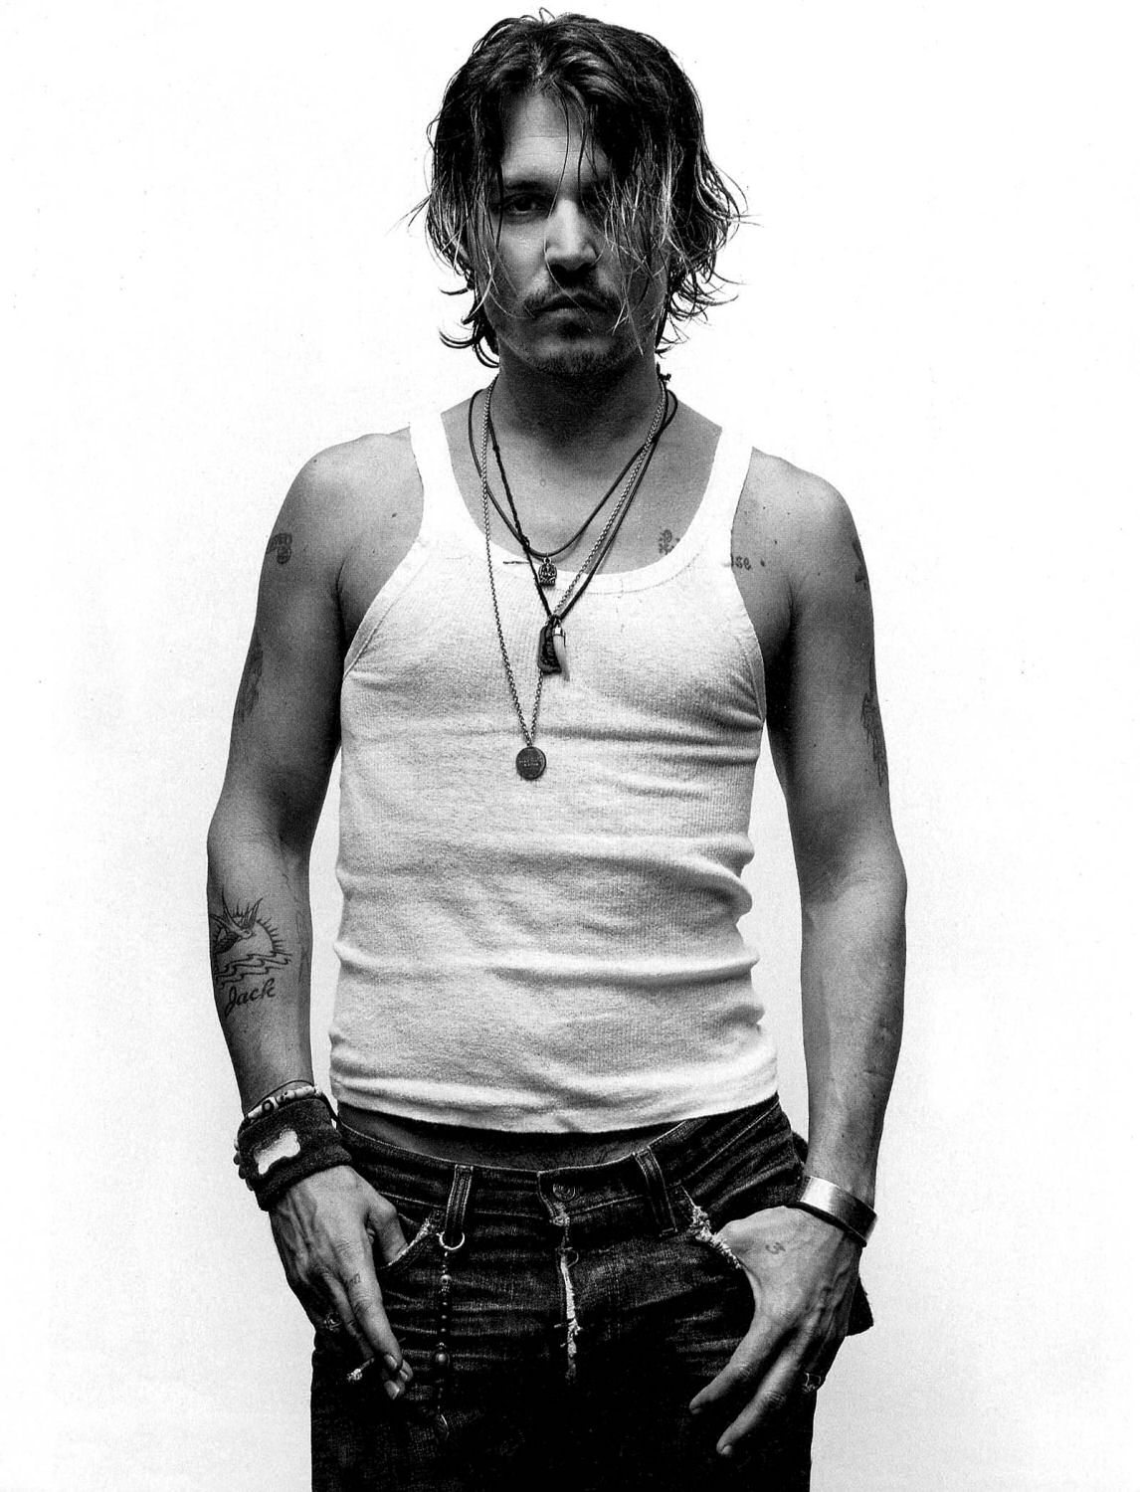
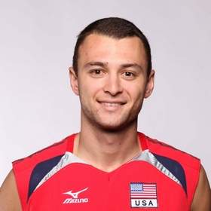
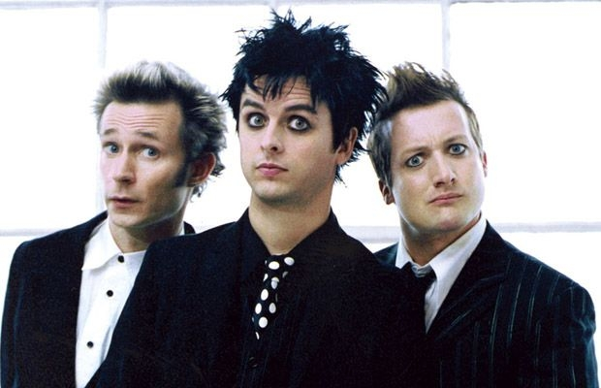
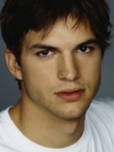
Famous people
Anderson Matthew-
a volleyball player.
Paul Lotman-
a volleyball player.
Johnny Depp- an actor.
Ashton Kutcher- an actor
Green Day-
a punk rock band.

Slide 9
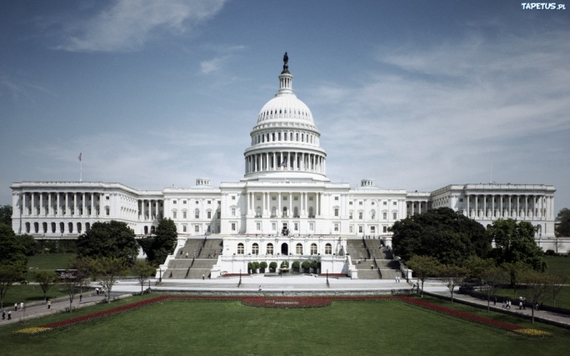
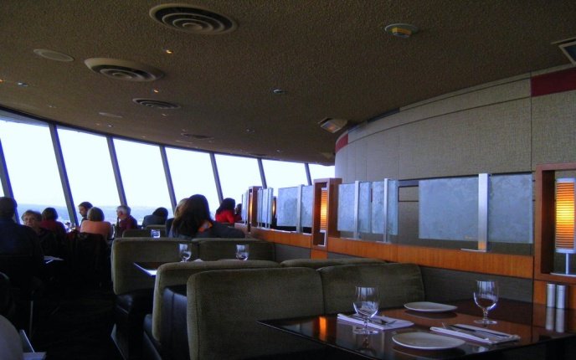
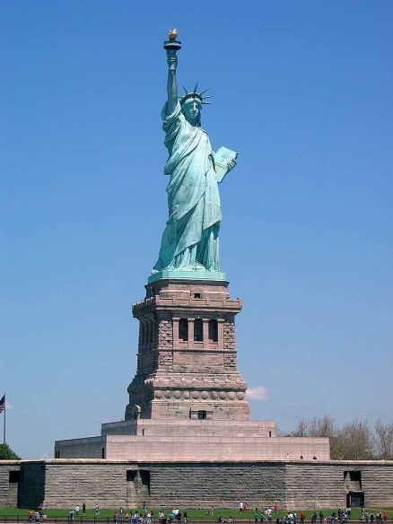
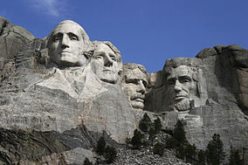
Famous places
The White House.
The Restaurant Space Needle.
The Statue of Liberty.
The Mount Rushmore
The Hollywood Walk of Fame on
Hollywood Boulevard

Slide 10
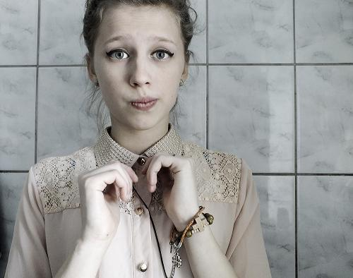
Wykonała Iwona Pintal ;)

