Slide 1
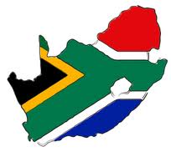
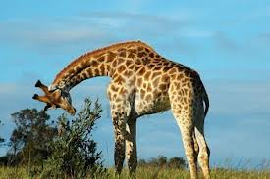
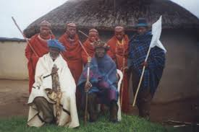
The Republic of south africa

Slide 2
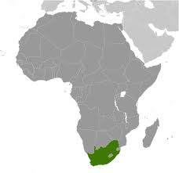
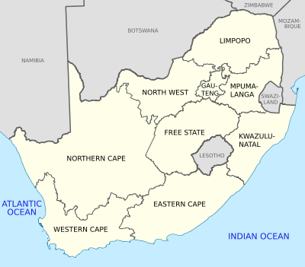
TERRITORY
South Africa, officially the Republic of South Africa, is a country located at the southern tip of Africa;
It is divided into nine provinces and has 2,798 km² of coastline.

Slide 3
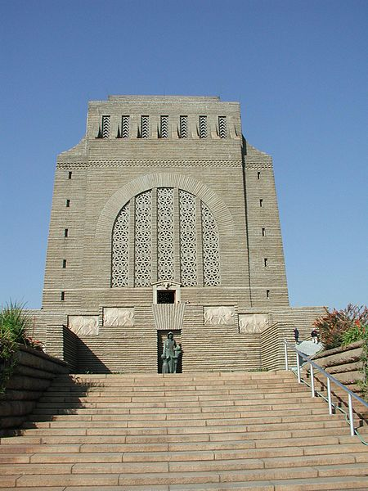
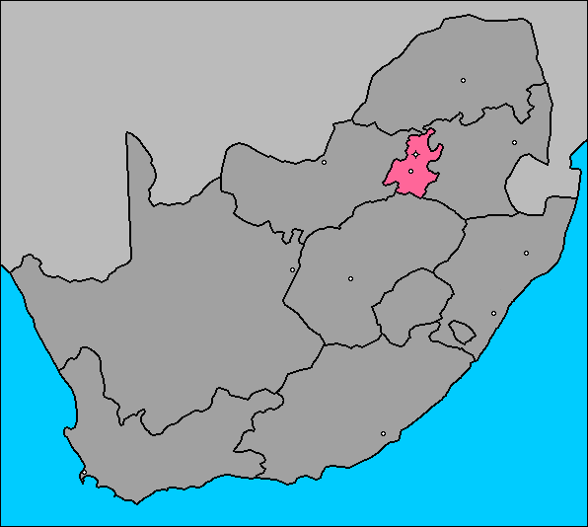
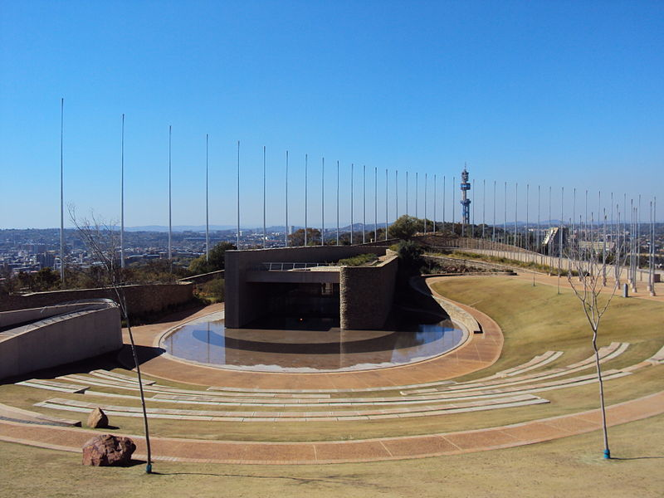
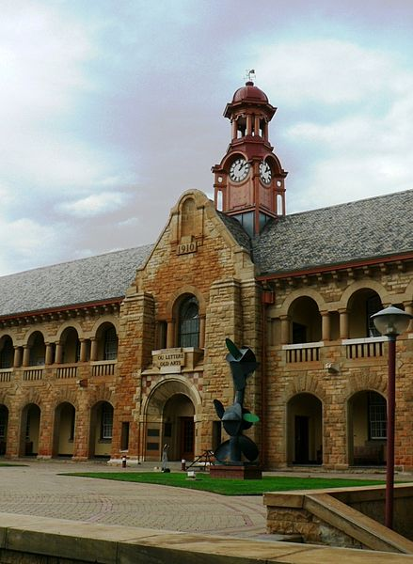
CAPITAL CITY
The Voortrekker Monument
Freedom Park's amphitheatre
South Africa has three capital cities:
Cape Town, as the seat of Parliament, is the legislative capital;
Pretoria, as the seat of the President and Cabinet, is the administrative capital;
Bloemfontein, as the seat of the Supreme Court of Appeal, is the judicial capital.
University of Pretoria's Old Arts Building

Slide 4
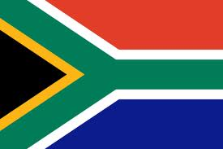
FLAG
Adopted on April 27, 1994
Red, white and blue are the colors of the flag represent the Netherlands and the white settlers in South Africa.
Black, green and gold are the colors of African resistance movements

Slide 5
NATIONAL ANTHEM
The text of the anthem
Nkosi sikelel' iAfrika Maluphakanyisw' uphondo lwayo, Yizwa imithandazo yethu, Nkosi sikelela, thina lusapho lwayo.
„Nkosi Sikelel' iAfrika’’ was composed in the 1897 by Enoch Sontonga, a Methodist school teacher.
Morena boloka setjhaba sa heso, O fedise dintwa le matshwenyeho, O se boloke, O se boloke setjhaba sa heso, Setjhaba sa South Afrika - South Afrika.
Uit die blou van onse hemel, Uit die diepte van ons see, Oor ons ewige gebergtes, Waar die kranse antwoord gee,
Sounds the call to come together, And united we shall stand, Let us live and strive for freedom, In South Africa our land.

Slide 6
LANGUAGE
South Africa has eleven official languages:

Slide 7
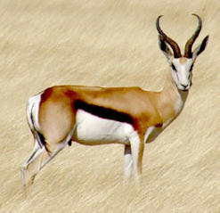
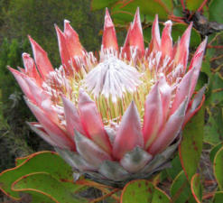
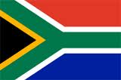
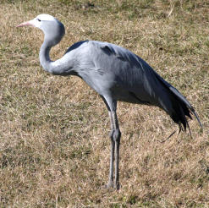
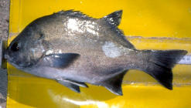
NATIONAL SYMBOLS
National animal Springbok
The National flower of South Africa The King Protea
National Flag
South Africa's national fish is the galjoen or black bream.
The National Coat of Arms
National bird Blue crane

Slide 8
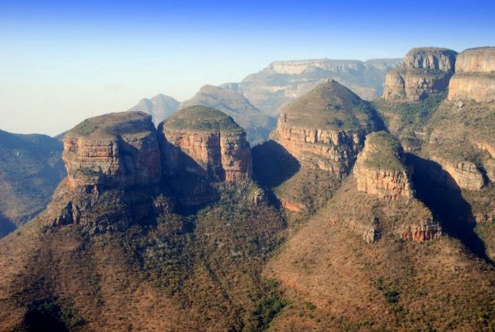
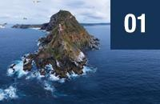
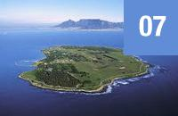
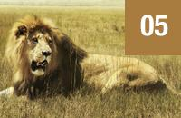
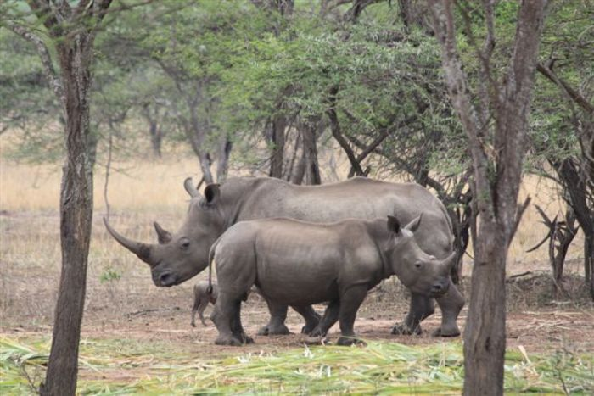
FAMOUS PLACES IN SOUTH AFRICA
Cape Peninsula
Robben Island
Kruger National Park

Slide 9
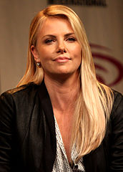
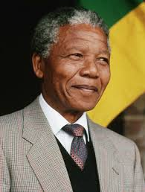
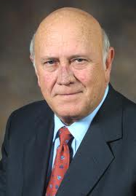
FAMOUS PEOPLE
Nelson Mandela - politician, leader of the African Congress, winner of the Nobel Peace Prize (1993).
Charlize Theron -
a Hollywood star
Frederik W. De Klerk
politician, the president and the
Prime Minister RSA, winner of the Nobel Peace Prize (1993).

Slide 10
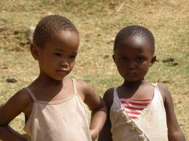
The End
Made by:
Monika Szymańska
Michał Polski
Sources:
www.wikipedia.pl
,,Planeta Nowa 2” geography textbook
www.google.pl

